Slide 1
OBJECT-ORIENTED SYSTEM DEVELOPMENT
Text Book: Object-oriented modeling and design with UML-Michael Blaha, James Rumbaugh, 2nd E

Slide 2
Objective of OOMD
Basic knowledge about software engineering and object oriented language
Will be able to use the Object Oriented standard UML notations
Easily create a modular design with components and relate the logical design to the physical environment
The Student will be able to use the concept of design patterns and apply it

Slide 3
What is Object Orientation?
Organize a software as collection of discrete objects that incorporate both data structures and behavior
OO includes four different aspects
Identity: data is quantized into discrete, distinguishable entities called Objects
Each object has its own inherent identity
Classification: means objects with the same data structures and behavior are grouped into a class
A Class is an abstraction that describes properties important to an application and ignores the rest

Slide 4
Object Orientation Contd.,
Inheritance: is sharing of attributes and operations among classes based on a hierarchical relationship
Each subclass incorporates or inherits all the features of its superclass and adds its own unique features
Polymorphism : same operation may behave differently for different classes.

Slide 5
What is Object Oriented Development?
OO development as a way of thinking about software based on abstractions that exist in the real world as well in the program
Main objective of OO development is the identification and organization of application concepts, rather than their final representation in programming language

Slide 6
Object Oriented Methodology
Process for OO development and graphical notation for representing OO concepts
System conception: Software development begins with business analyst and formulating tentative requirements
Analysis: scrutinizes and rigorously restate the requirements of the software
The analysis model is a precise abstraction of “what the desired system must do, not how it will be done”

Slide 7
OO Methodology Contd..,
The analysis model has two parts: the domain model and the application model.
Domain model is a description of the real-world object reflected within the system
Application model is a description of the parts of the application system

Slide 8
OO Methodology Contd..,
System design: The development team devises a high level strategy – the system architecture for solving the application problem
The system designer must decide what performance characteristics to optimize,chooses a strategy of attacking the problem and make tentative resource allocation
Class design: The class designer adds details to the analysis model in accordance with the system design strategy

Slide 9
OO Methodology Contd..,
Implementation: Implementers translate the classes and relationships developed during class design into particular programming language, database or hardware
It is important to follow good software engineering practice during coding

Slide 10
Three Models
Three models to describe a system from different viewpoints
Class model: Describes the static structure of the objects in a system and their relationships (class diagrams)
State Model: Describes the aspects of an object that change over time.( State Diagrams)
Interaction model: Describes how the objects in a system cooperate to achieve broader results. (Use cases, Sequence diagrams, activity diagrams.)

Slide 11
Object oriented Themes
Several themes pervade OO technology
Abstraction: let’s focus on essential aspects of an application while ignoring details
Encapsulation : (Information Hiding) separates the external aspects of an object ,that are accessible to other objects from internal implementation details.

Slide 12
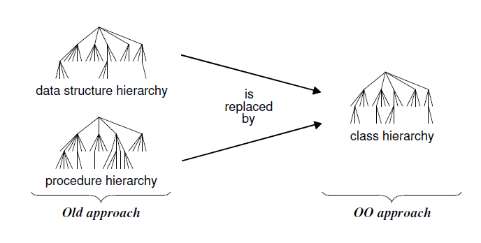
Object oriented Themes
Combining data and Behavior
Sharing: inheritance of both data structure and behavior lets subclass share common code

Slide 13
Modeling As A Design Technique
Modeling
A model is an abstraction of something for the purpose of understanding it before building it.
Testing a physical entity before building it: Engineers test scale models of airplanes, cars and boats in wind tunnels and water tanks to improve their dynamics.
Communication with customers : Architects and product designers build models to show their customers

Slide 14
Modeling As A Design Technique
Visualization: Storyboards of movies, television shows and advertisements let writers see how their ideas flow.
Reduction of complexity: The main reason for modeling is to deal with systems that are too complex to understand directly.
Models reduce complexity by separating out a small number of important things to deal with at a time

Slide 15
Abstraction
The goal of abstraction is to isolate those aspects that are important for some purpose and suppress those aspects that are unimportant.
The Three models
Class Model: describes the structure of objects in a system, their identity, their relationships to other objects, their attributes and their operations
Our goal in constructing a class model is to capture those concepts from the real world that are important to an application

Slide 16
The Three models
State Model: describes those aspects of objects concerned with time and the sequencing of operations
The State model captures control the aspects of a system that describes the sequence of operations that occur
Interaction Model: describes interactions between objects – how individual objects collaborate to achieve the behavior of the system as a whole

Slide 17
Class Modeling
Objects and Class Concepts
An object is a concept, abstraction or thing with identity that has meaning for an application
Some objects have real world counter parts while others are conceptual entities
All objects have identity and are distinguishable

Slide 18
Class Modeling Contd..,
Classes
An object is an instance or occurrence of a class.
A class describes a group of objects with the same properties (attributes), behavior (operations), kinds of relationships
Person, company are all classes

Slide 19
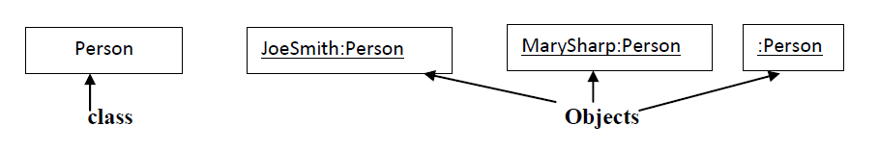
Class Modeling Contd..,
Class diagrams
A class diagram corresponds to an infinite set of object diagrams.
The UML symbol for an object is a box with an object name followed by a colon and the class name
The UML symbol for a class also is a box. Our convention is to list the class name in bold face, center the name and capitalize the first letter

Slide 20
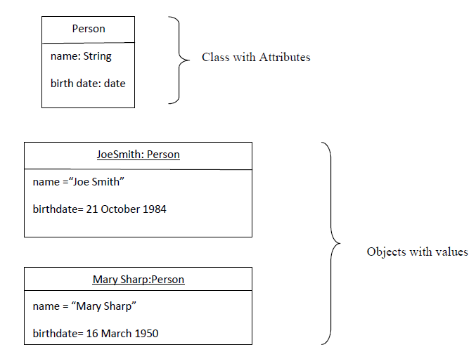
Class Modeling Contd..,
Values and Attributes
A value is a piece of data.
An attribute describes a value held by each object of the class
Objects is to class as value is to attribute

Slide 21
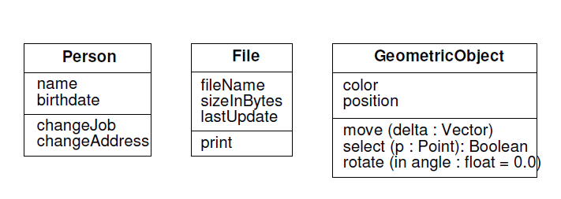
Class Modeling Contd..,
Operations and Methods
An operation is a function or procedure that may be applied to or by objects in a class
All objects in a class share the same operations . The same operation may apply to many different classes. Such an operation is polymorphic.
A method is the implementation of an operation for a class

Slide 22
Link and Association Concepts
Links and Associations
A link is a physical or conceptual connection among objects
An association is a description of a group of links with common structure and common semantics.
The UML notation for a link is a line between objects, if the link has a name, it has to be underlined
The association name is optional, if the model is unambiguous

Slide 23
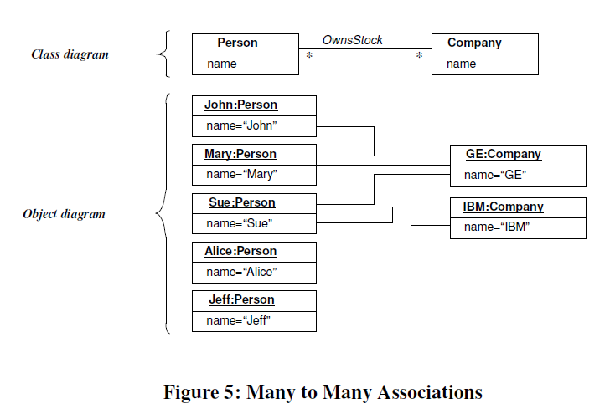
Link and Association Concepts

Slide 24
Link and Association Concepts
Multiplicity
specifies the number of instances of one class that may relate to a single instance of an associated class
UML diagrams explicitly list multiplicity at the ends of association lines
UML specifies: “1”: exactly one,
“1 ..*” (one or more)
“3..5” (three to five inclusive)

Slide 25
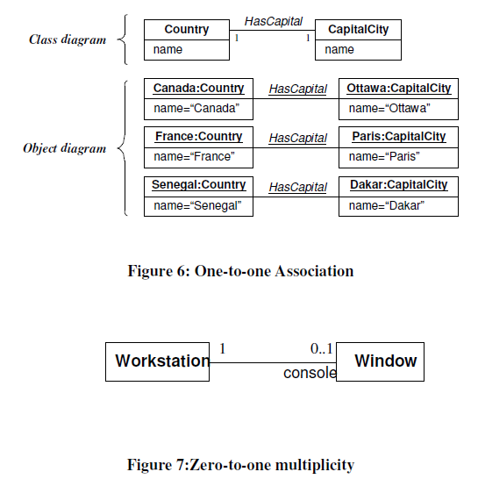
Link and Association Concepts

Slide 26
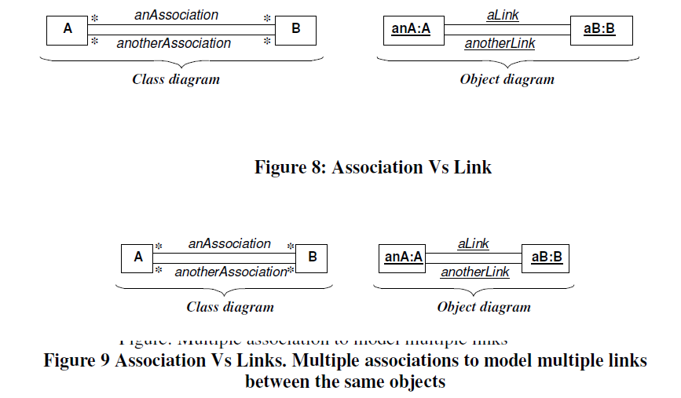
Link and Association Concepts

Slide 27
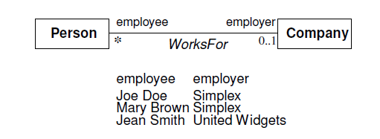
Link and Association Concepts
Association End names:
can give names to the association link
Association end names often appear as nouns in problem descriptions.
Use of association end names is optional, but it is often easier and less confusing to assign association end names

Slide 28
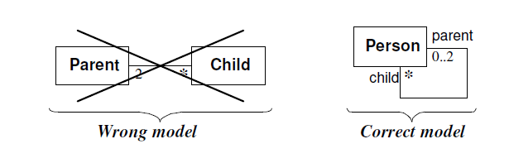
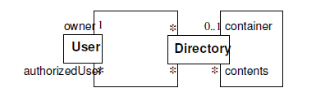
Link and Association Concepts

Slide 29
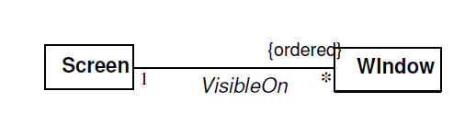
Link and Association Concepts
Ordering
The ordering is an inherent part of the association
Ordered set of objects are indicated by writing “{ordered}” next to the appropriate association end

Slide 30
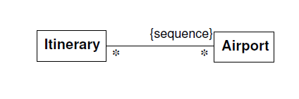
Link and Association Concepts
Bags and sequences
Bag: collection of elements with duplicates allowed
Sequence: ordered collection of elements with duplicate allowed

Slide 31
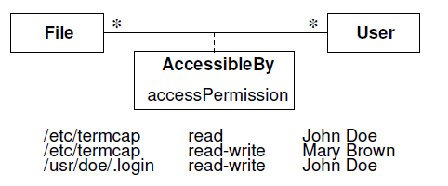
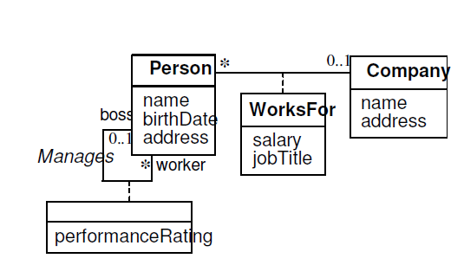
Link and Association Concepts
Association Classes

Slide 32
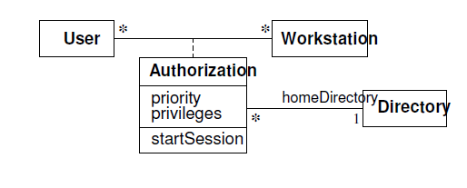
Link and Association Concepts

Slide 33
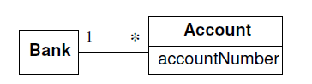
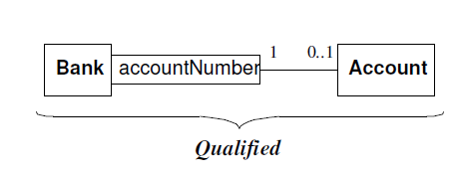
Link and Association Concepts
Qualified Associations
An association in which an attribute called the qualifier disambiguates the objects for a “many” association end
Job of qualifier is to reduce the many association to one

Slide 34
Generalization and inheritance
Generalization is the relationship between a class (the super class) and one or more variations of the class (sub class)
Super class holds the common attributes, operations and associations. Subclass adds specific attributes
Generalization is sometimes called the ”is–a” relationship, because each instance of a sub class is a instance of the super class as well

Slide 35
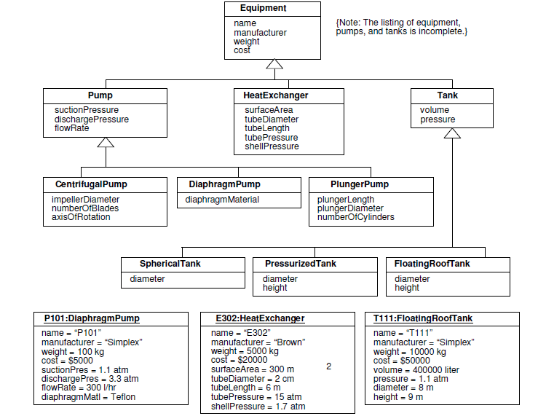
Generalization and inheritance

Slide 36
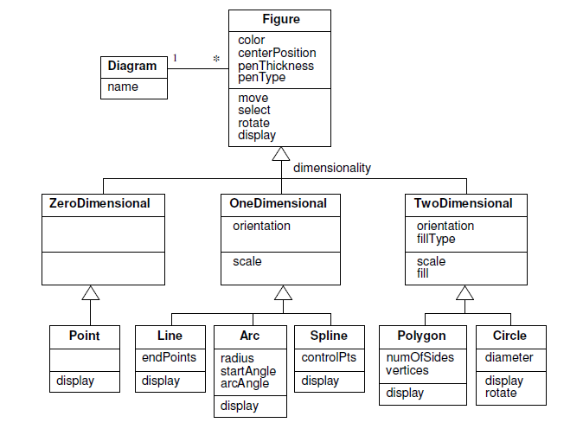
Generalization and inheritance

Slide 37
Generalization and inheritance
Use of Generalization
Support for polymorphism.
Second purpose is to structure the description of objects.( a taxonomy is formed)
Third purpose is to enable reuse of code

Slide 38
Generalization and inheritance
Overriding Features
A subclass may override a super class feature by defining a feature with the same name.
To specify behavior that depends on the sub class
To tighten the specification of a feature or to improve performance

Slide 39
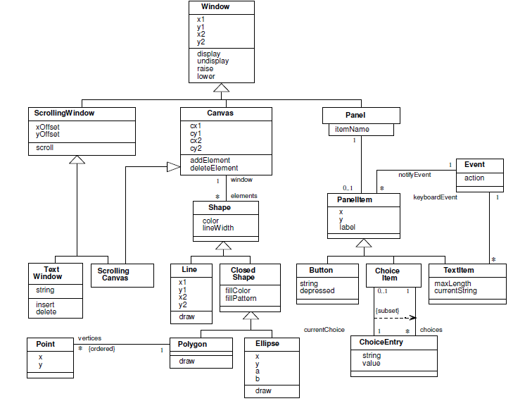
A Sample Class Model

Slide 40
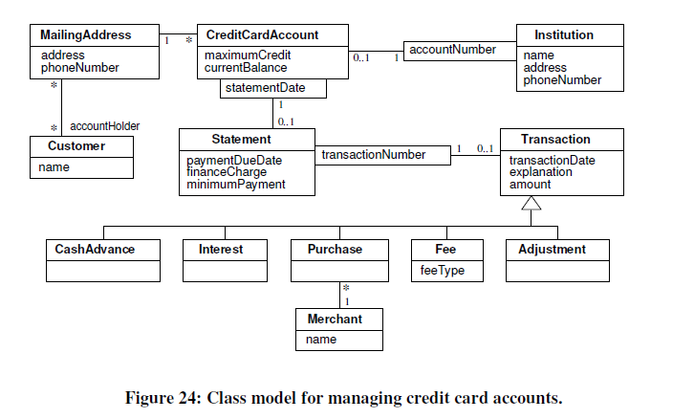
Navigation of class model

Slide 41
OCL Constructs for traversing Class Models
Attributes: You can traverse from an object to an attribute value
Syntax: source object, followed by a dot and then the attribute name
Example: aCreditCardAccount. maximumCredit
Operations: You can also invoke an operation for an object or a collection of objects
Syntax: source object or object collection, followed by a dot and then the operation.
The OCL has special operations that operate on entire collections. The syntax for a collection operation is the source object collection followed by “→” and then the operation

Slide 42
OCL Constructs for traversing Class Models
Simple associations: A 3rd use of dot notation is to traverse an association to a target end
Example: aCustomer.MailingAddress yields a set of addresses for a customer. In contrast, aCreditCardAccount.MailingAddress yields a single address.
Association classes: Given a link of an association class, you can find the constituent objects

Slide 43
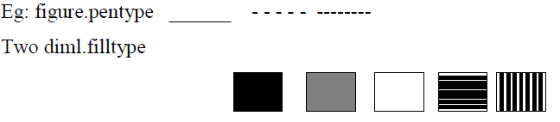
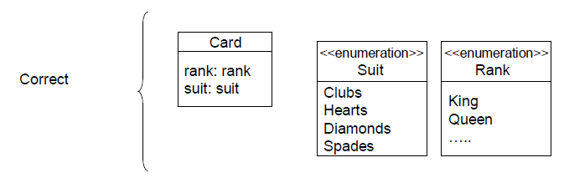
Advanced Class Modeling
Enumerations
A Data type that has a finite set of values

Slide 44
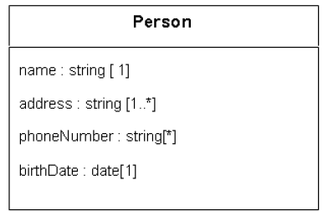
Advanced Class Modeling
Multiplicity
Multiplicity of an attribute specifies the number of possible values for each instantiation of an attribute

Slide 45
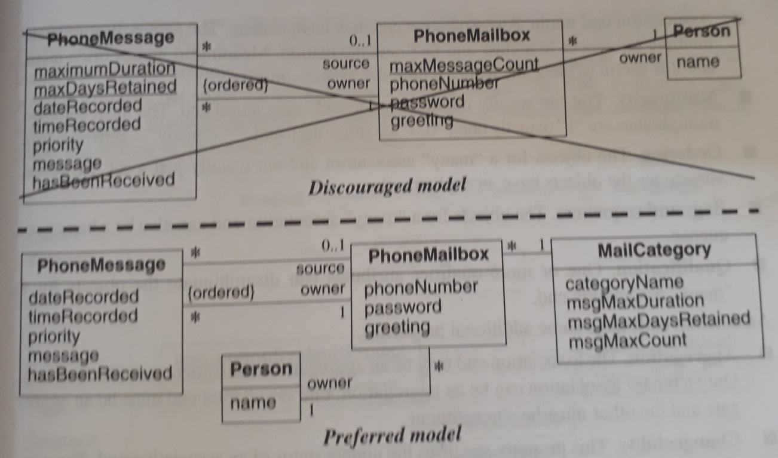
Advanced Class Modeling
Scope
Scope indicates if a feature applies to an object or a class.

Slide 46
Advanced Class Modeling
Visibility
Visibility refers to the ability of a method to reference a feature from another class and has the possible values of public, protected, private, and package.
The UML denotes visibility with a prefix. “+” public, “-” private, “#” protected, “~” package.
Lack of a prefix reveals no information about visibility

Slide 47
Advanced Class Modeling
Several issues to consider when choosing visibility are
Comprehension: understand all public features to understand the capabilities of a class
Extensibility: many classes can depend on public methods, so it can be highly disruptive to change their signature
Context: private, protected, and package methods may rely on preconditions or state information created by other methods in the class

Slide 48
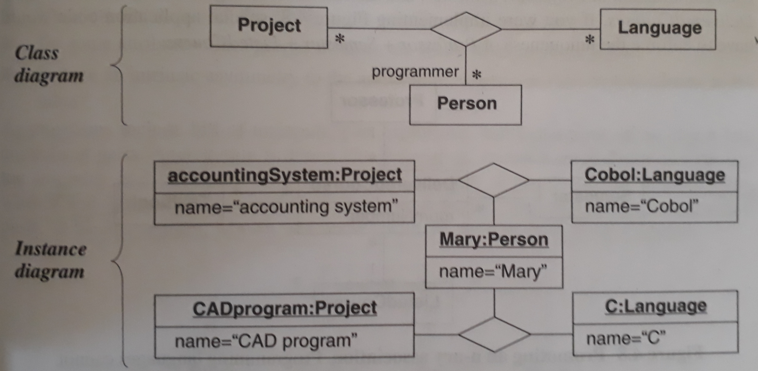
N-ary Association

Slide 49
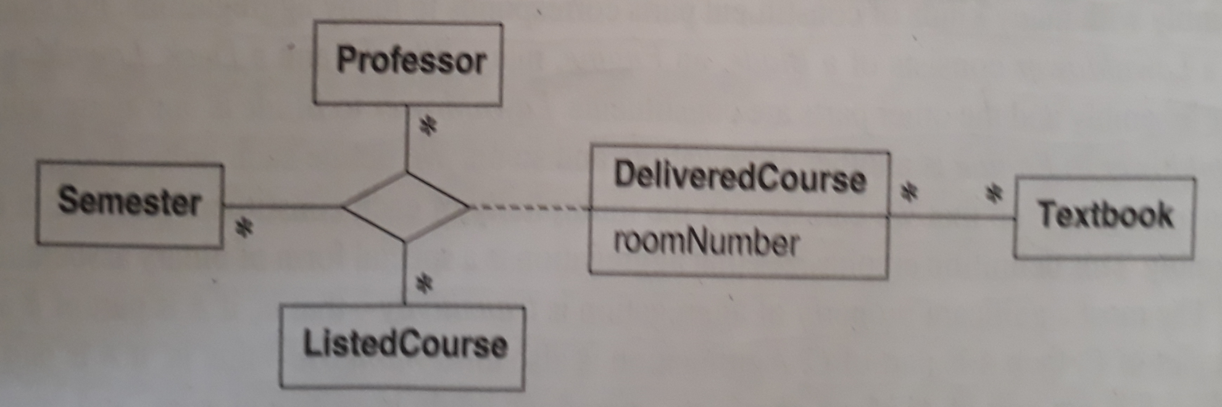
N-ary Association

Slide 50
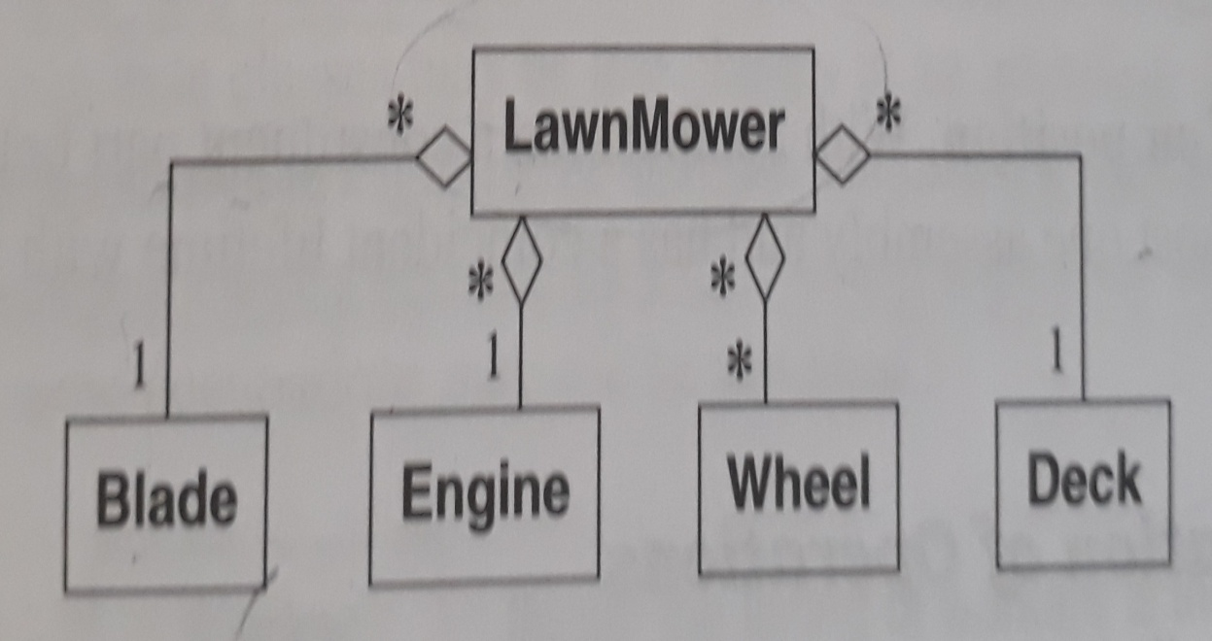
Aggregation
Aggregation is a strong form of association in which an aggregate object is made of constituent parts
We define an aggregation as relating an assembly class to one constituent part class

Slide 51
Aggregation
Aggregation versus Association
Aggregation is a special form of association, not an independent concept.
If two objects are tightly bound by a part-whole relationship, it is an aggregation. If the two objects are usually considered as independent, even though they may often be linked, it is an association.

Slide 52
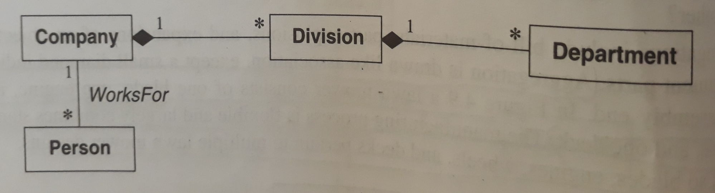
Aggregation
Aggregation versus Composition
composition implies ownership of the parts by the whole.

Slide 53
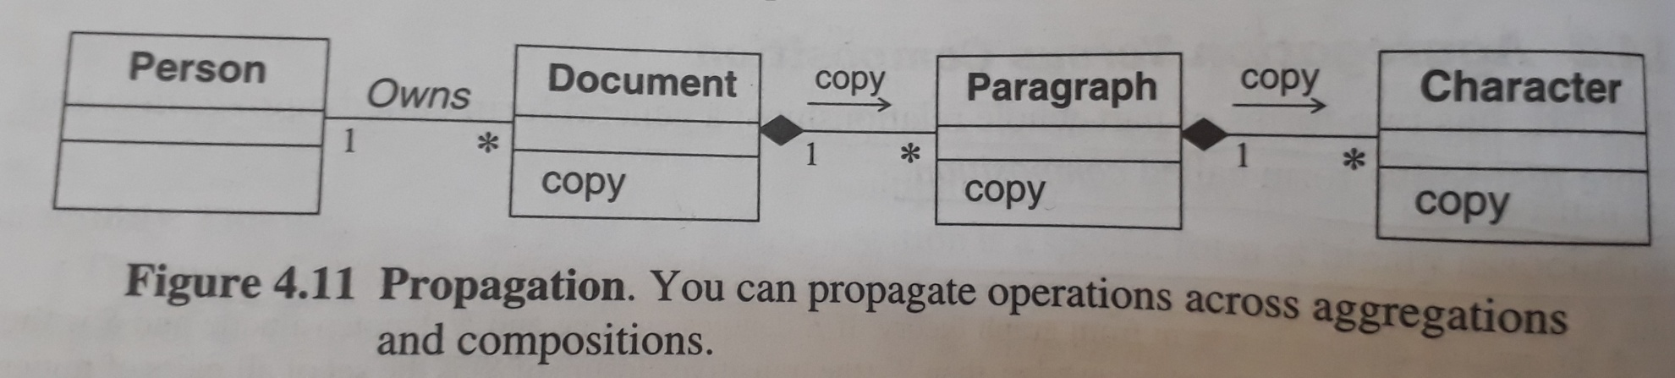
Aggregation
Propogation of Operations
Automatic application of an operation to a network of objects when the operation is applied to some starting objects

Slide 54
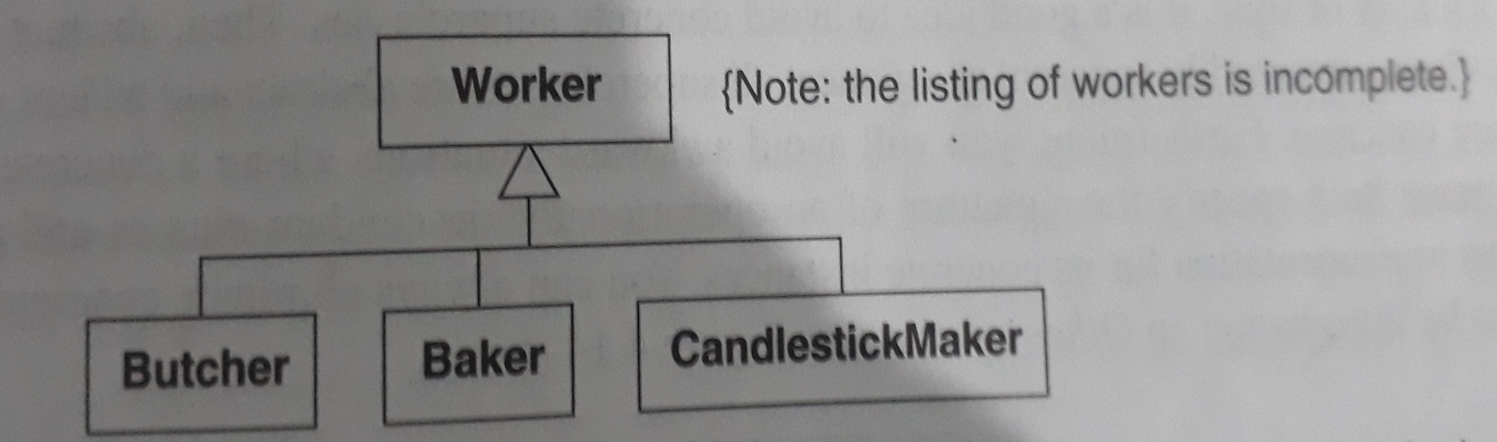
Abstract Classes
Abstract class is a class that has no direct instances but whose descendant classes have direct instances.
A concert class is a class that is insatiable; that is, it can have direct instances.

Slide 55
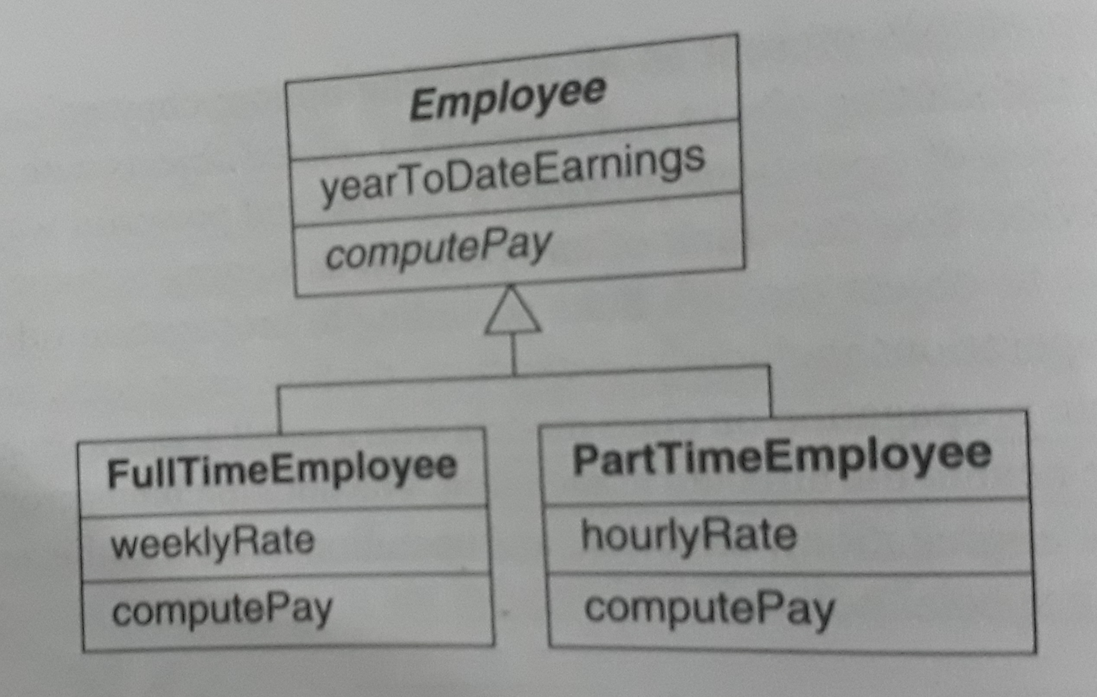
Abstract Classes

Slide 56
Multiple Inheritance
Multiple inheritance permits a class to have more than one superclass and to inherit features from all parents
The advantage of multiple inheritance is greater power in specifying classes and an increased opportunity for reuse

Slide 57
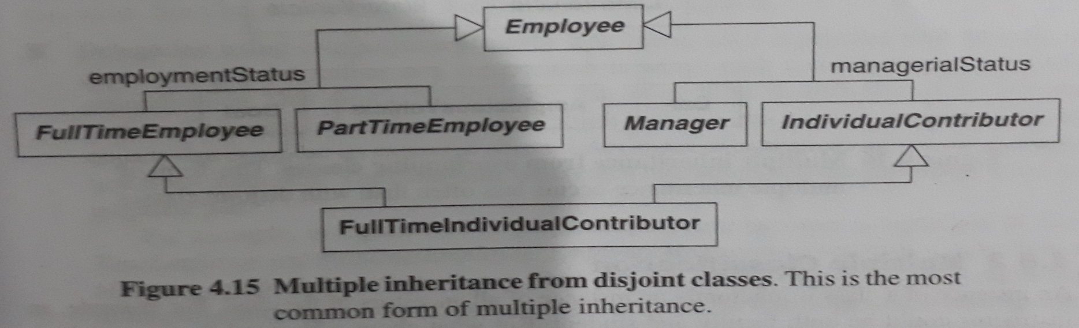
Multiple Inheritance
Kinds of Multiple Inheritance
The most common form of multiple inheritance is from sets of disjoint classes. Each subclass inherits from one class in each set.

Slide 58
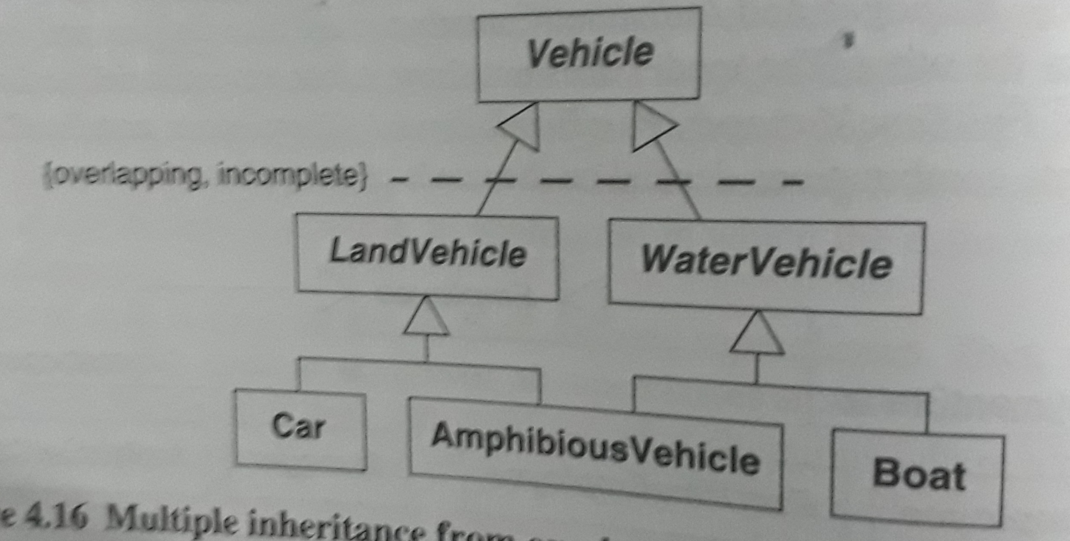
Multiple Inheritance

Slide 59
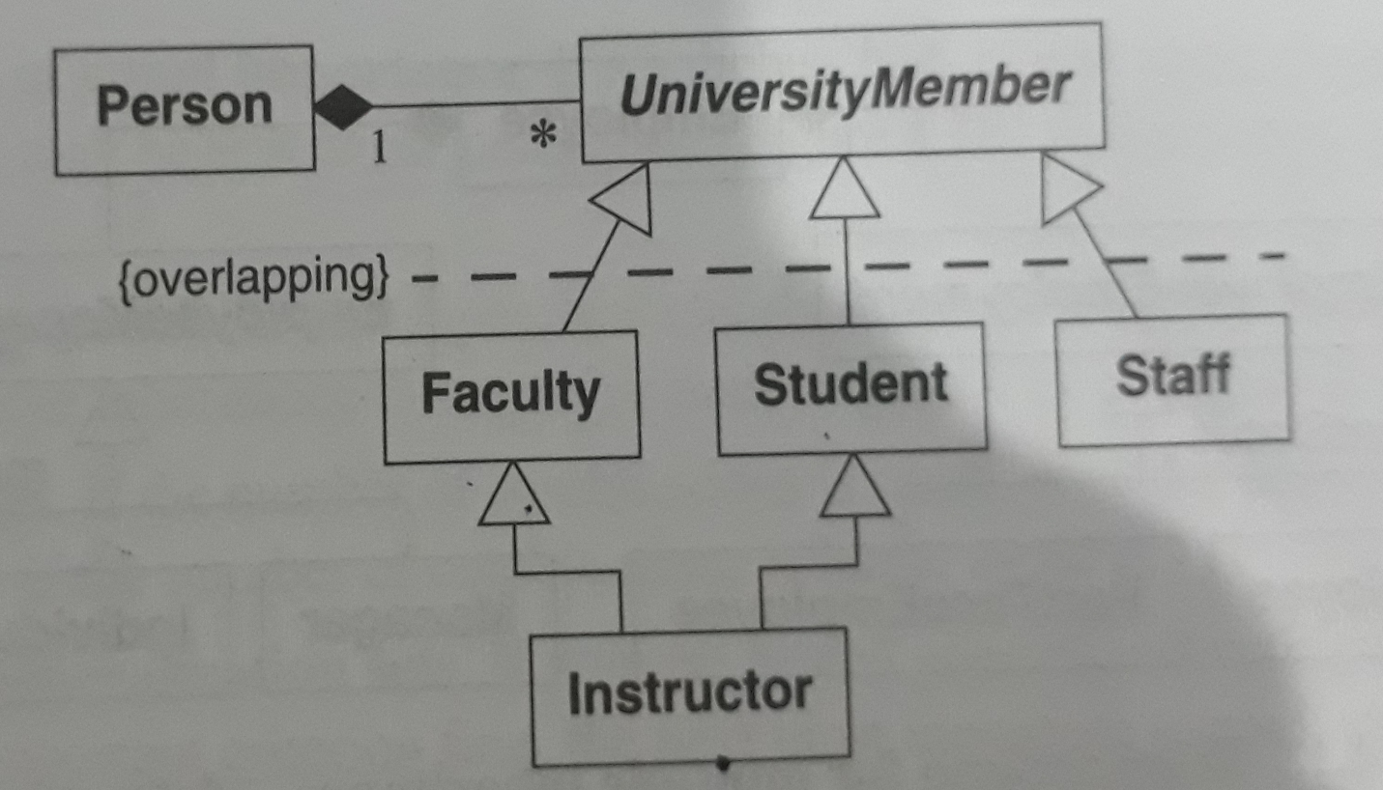
Multiple Inheritance
Multiple Classification
Multiple classification in which one instance happens to participate in two overlapping classes

Slide 60
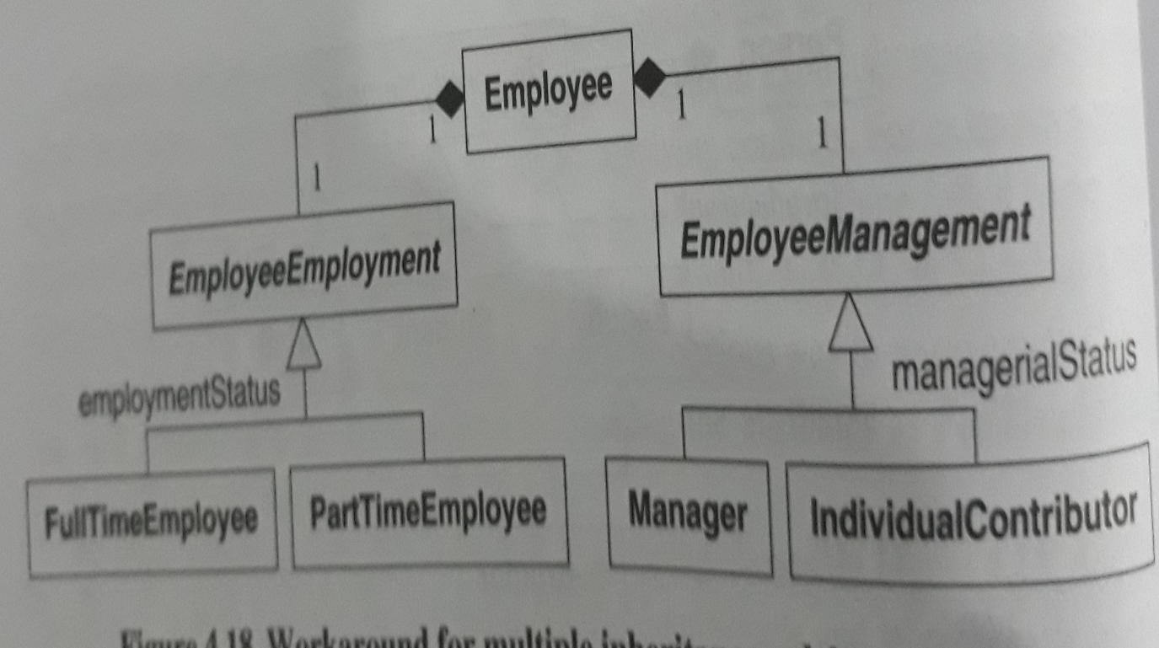
Multiple Inheritance
Workarounds
Delegation using composition of parts:

Slide 61
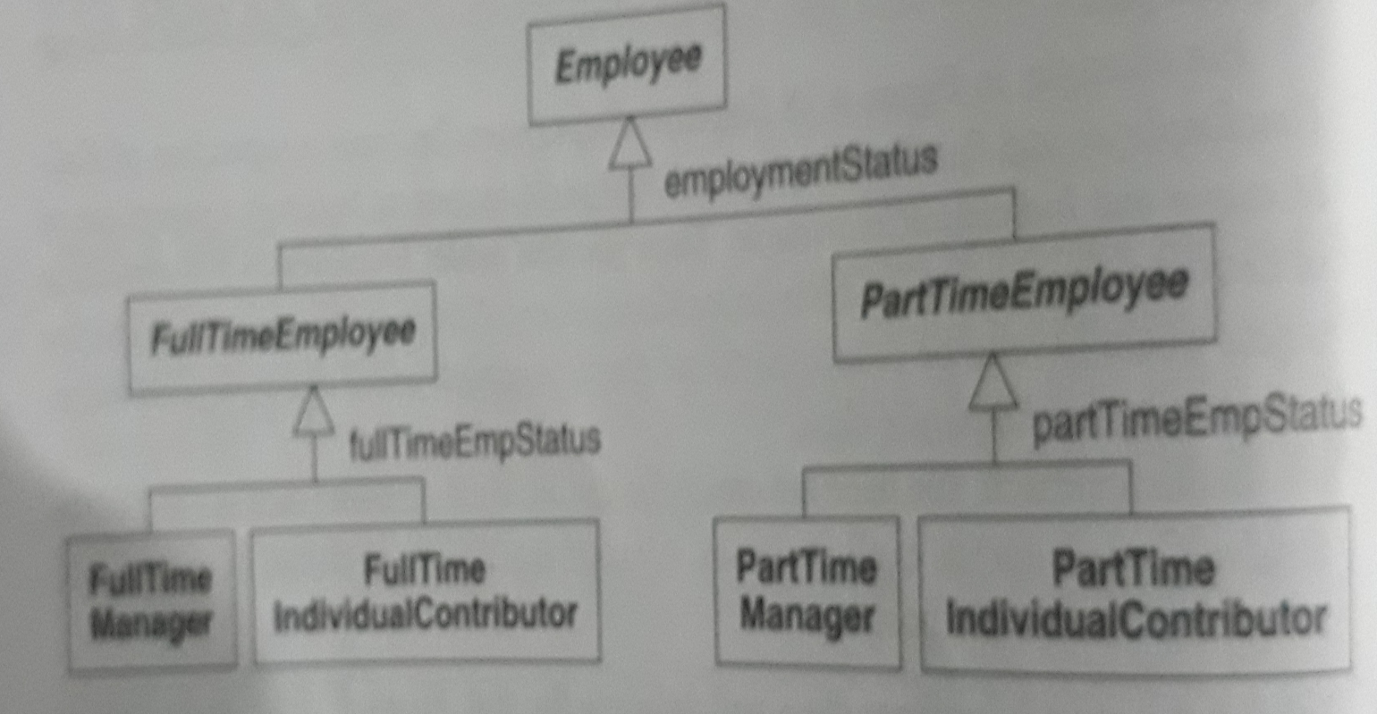
Multiple Inheritance
Nested generalization:

Slide 62
Multiple Inheritance
Superclasses of equal importance: if a subclass has several super classes, all of equal importance, it may be best to use delegation
Dominant superclass: if one superclass clearly dominates and the others are less important, preserve inheritance through this path
Few subclasses: if the number of combinations is small, consider nested generalization
Sequencing generalization sets: if we use generalization, factor on the most important criterion first, the next most important second, and so forth
Large quantities of code: try to avoid nested generalization if we must duplicate large quantities of code.

Slide 63
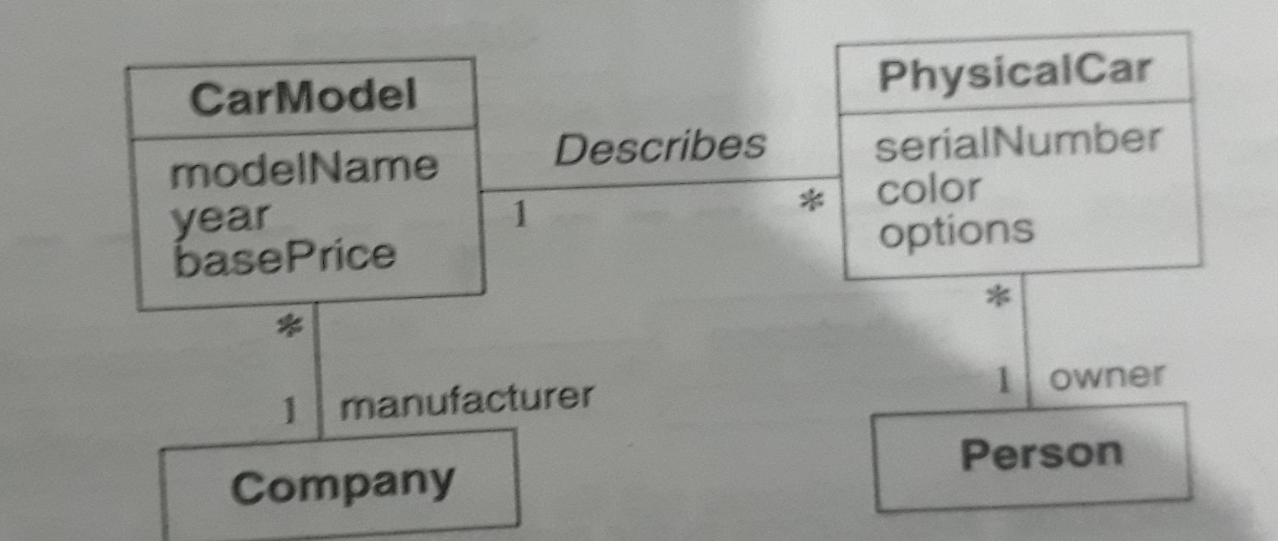
Metadata
Metadata is data that describes other data. For example, a class definition is a metadata.

Slide 64
Reification
Reification is the promotion of something that is not an object into an object
On occasion it is useful to promote attributes, methods, constraints, and control information into objects so you can describe and manipulate them as data.

Slide 65
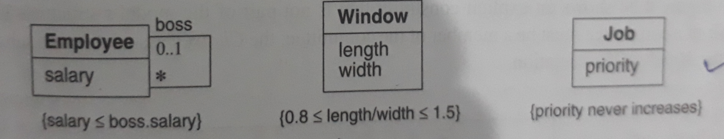
Constraints
Constraint is a Boolean condition involving model elements, such as objects, classes, attributes, links, associations, and generalization sets
A Constraint restricts the values that elements can assume

Slide 66
Constraints
Constraints on generalization sets :
Disjoint: Each object belongs to exactly one of the different classes.
Overlapping: The subclasses can share same objects. An object may belong to more than one subclass
Complete: The generalization lists all the possible subclasses
Incomplete: The generalization may be missing some subclasses

Slide 67
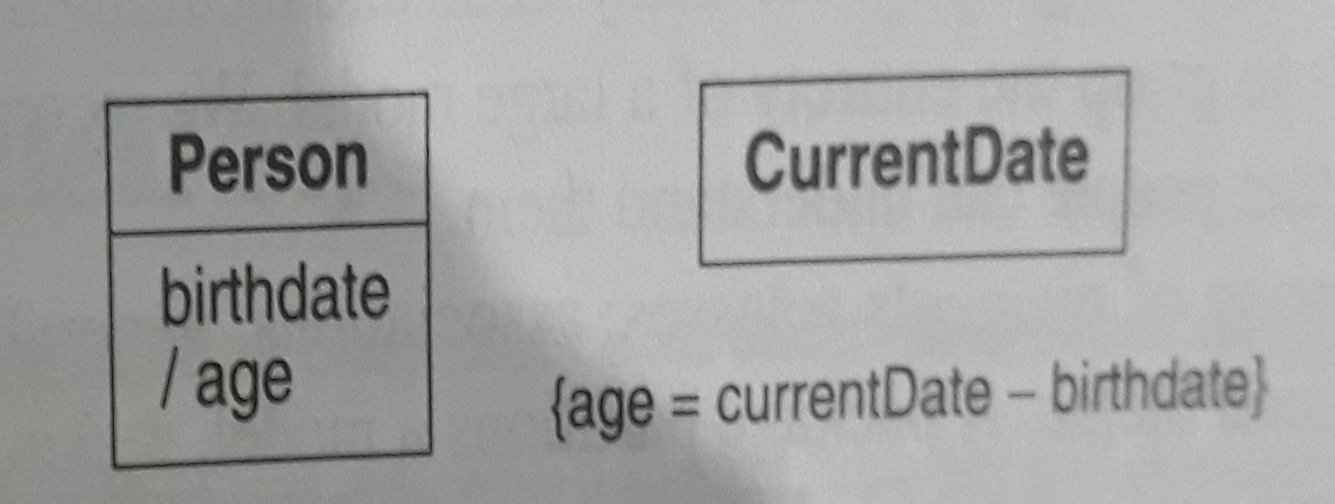
Derived Data
A derived element is a function of one or more elements, which in turn may be derived.
The notation for a derived element is a slash in front of the element name along with constraint that determines the derivation

Slide 68
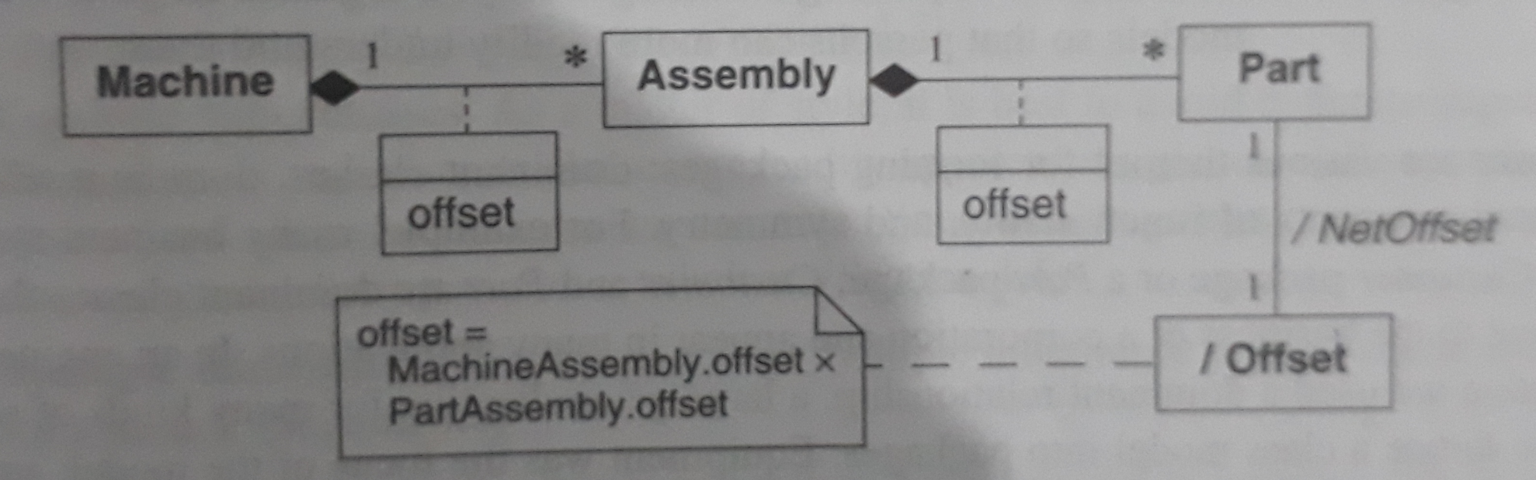
Derived Data

Slide 69
Packages
A package is a group of elements (classes, association, generalization, and lesser packages) with a common theme
A package partitions a model making it easier to understand and manage. Large applications my require several tiers of packages

